Slide 1
“I first understood, with a sudden clarity, the purpose of a paragraph…
I realized that a paragraph was a fence that held words…The words inside a paragraph worked together for a common purpose….I began to think of everything in terms of paragraphs. Our reservation was a small paragraph within the United States. My family’s house was a paragraph, distinct from the other paragraphs…” (Alexie, 130).
Comics= “a three dimensional paragraph” reading through image and text—other things the fence contain like space

Slide 2
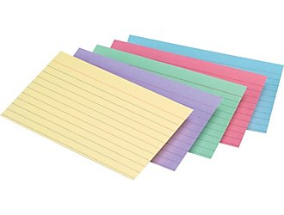
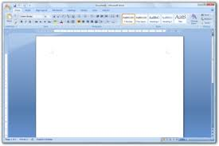
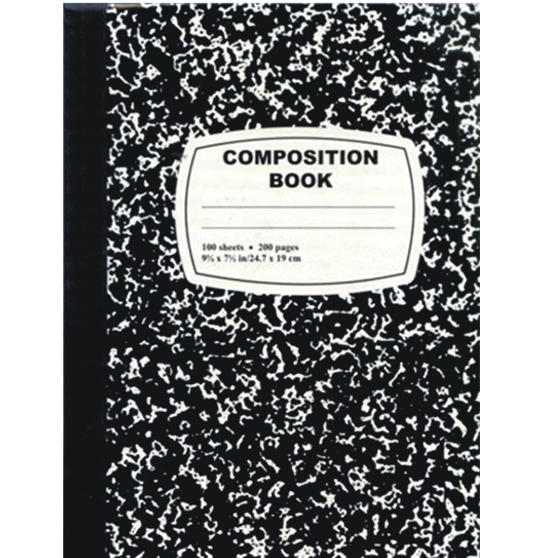

Slide 3
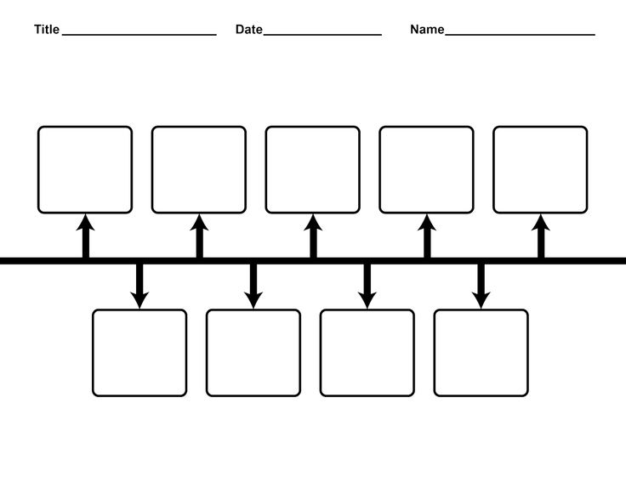
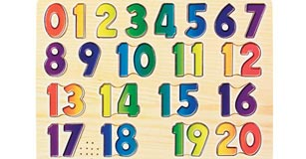
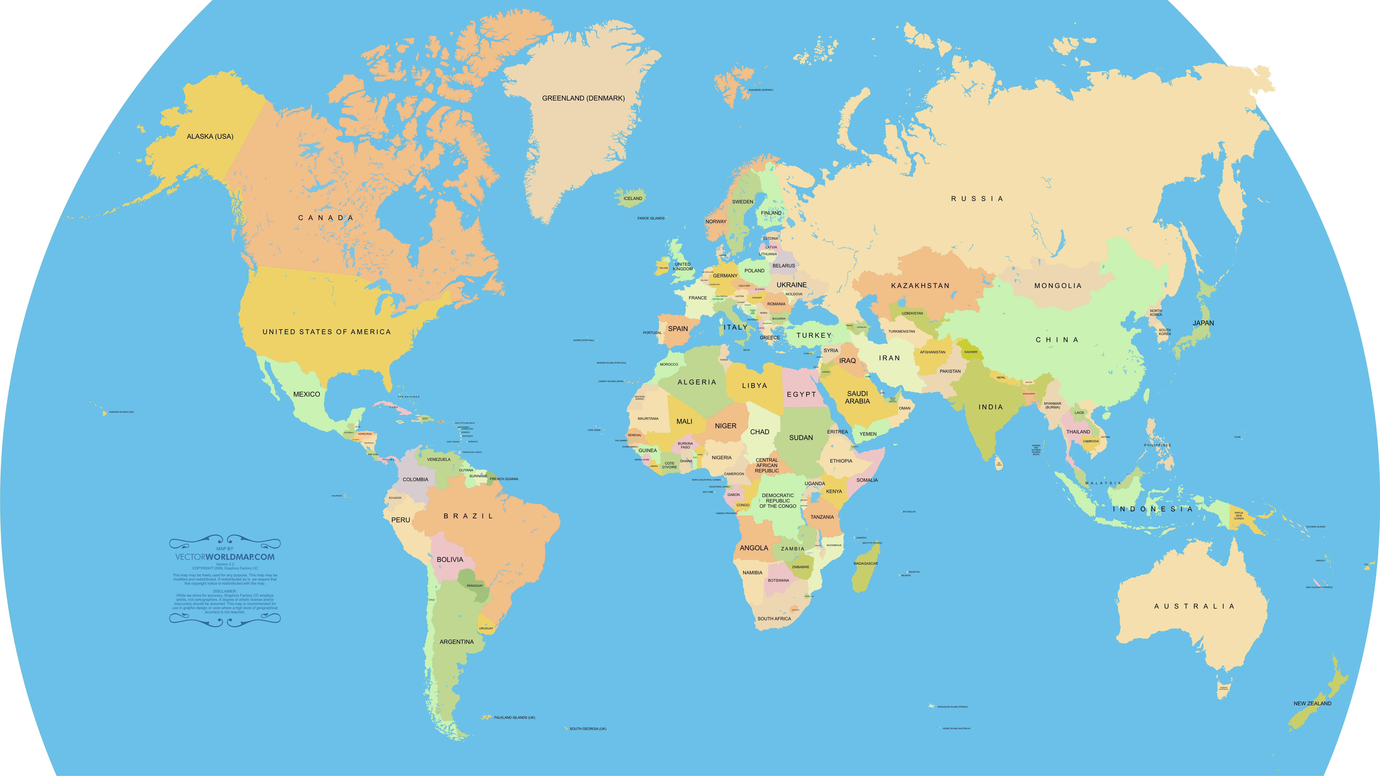
( Entirety of Educational Experiences in Composition )

Slide 4
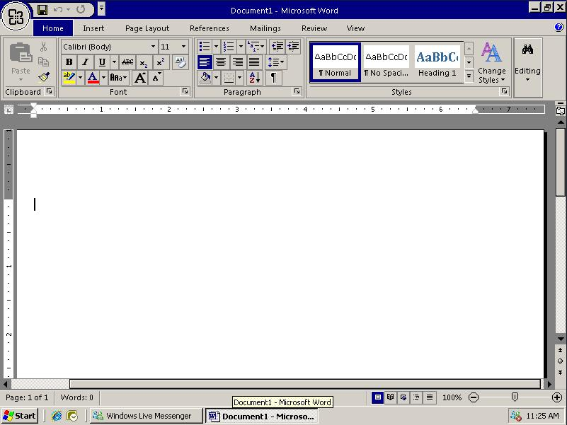
My Poetry is better this way! ★✪

Slide 5
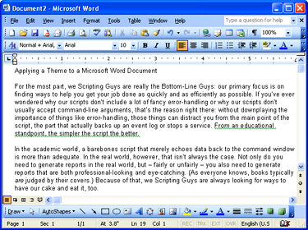
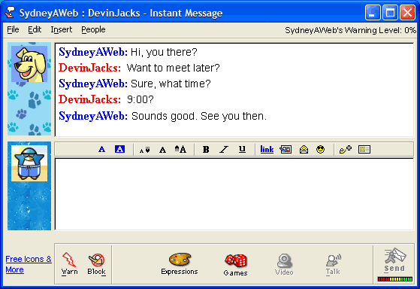

Slide 6
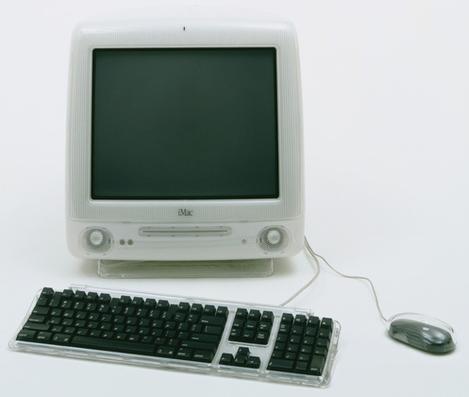
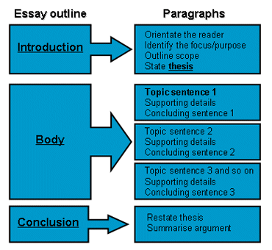
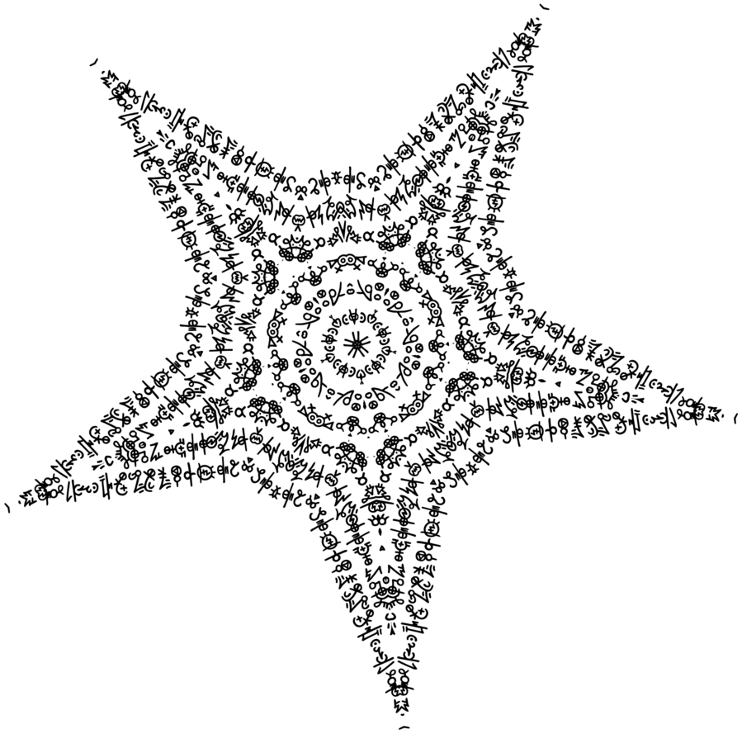
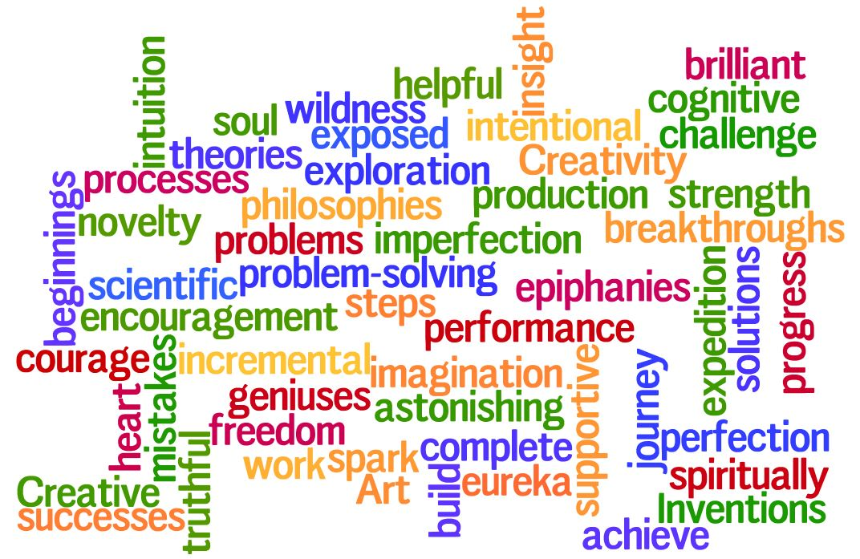
Text=
Art =
Text=
Art
Learning various digital word processors at once =
Combined methods of reading/writing/discourse

